Slide 1

Phishing Email Detector using AI
Topic: AI in Social Engineering and Phishing Campaigns
Project Done By: Swayam Sandeep Chougule, Siddhant Ravindra Patil
College: Parle Tilak Vidyalaya Association’s SATHAYE COLLEGE (AUTONOMOUS)

Slide 2

Introduction to AI-Powered Phishing Detection
Phishing & Social Engineering
AI in Cybersecurity
Machine learning detects patterns to block threats.
Attacks that deceive users to steal sensitive information.
Impact
I4C reports $20 million losses from cybercrime in 2024, phishing major factor.

Slide 3

The Problem: Traditional Detection Methods Fall Short
Method Limitations
Human Element
Blacklist and signatures fail against new tactics.
Phishing exploits human psychology and trust.
Statistics
174% breaches involve human factors, India Cybersecurity Breach Insights. 2024

Slide 4
Our Solution: AI-Driven Phishing Email Detection
Key Features
How It Works
Natural Language Processing
Analyzes email content and sender details for threats.
Machine Learning Algorithms
Detects suspicious URLs by pattern recognition.
Behavior & Anomaly Analysis

Slide 5





Code/Tool Breakdown: Key Components and Technologies
Python
Deep Neural Networks
Data Preprocessing
Main language for AI model development
Tokenization and feature extraction techniques
Core AI model architecture for detection
Cloud Platforms
Deployment using AWS and Azure

Slide 6
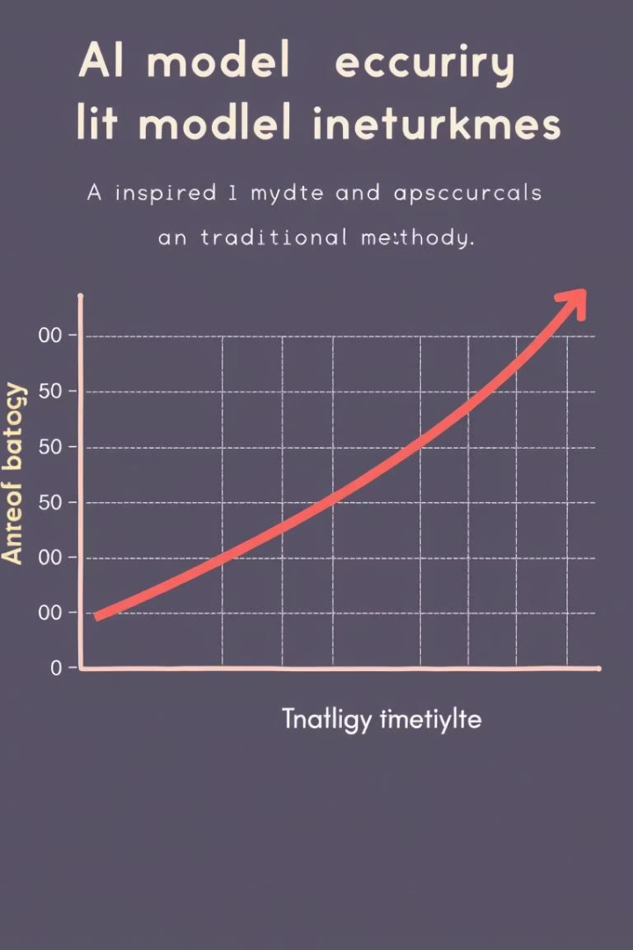
AI Model Training and Evaluation
1
Data Preparation
Cleaning and labeling phishing vs legitimate emails
2
Training
Model learns features using labeled datasets
3
Evaluation
Measured by accuracy, precision, recall, F1-score
4
Results
95% detection accuracy, outperforming traditional 70%

Slide 7
Real-World Use Cases: Protecting Organizations and Individuals
Enterprise Protection
Email System Integration
Success Story
Reduces data breaches and financial losses significantly.
Seamless with existing security infrastructure.
80% fewer phishing incidents in a mid-size company.

Slide 8
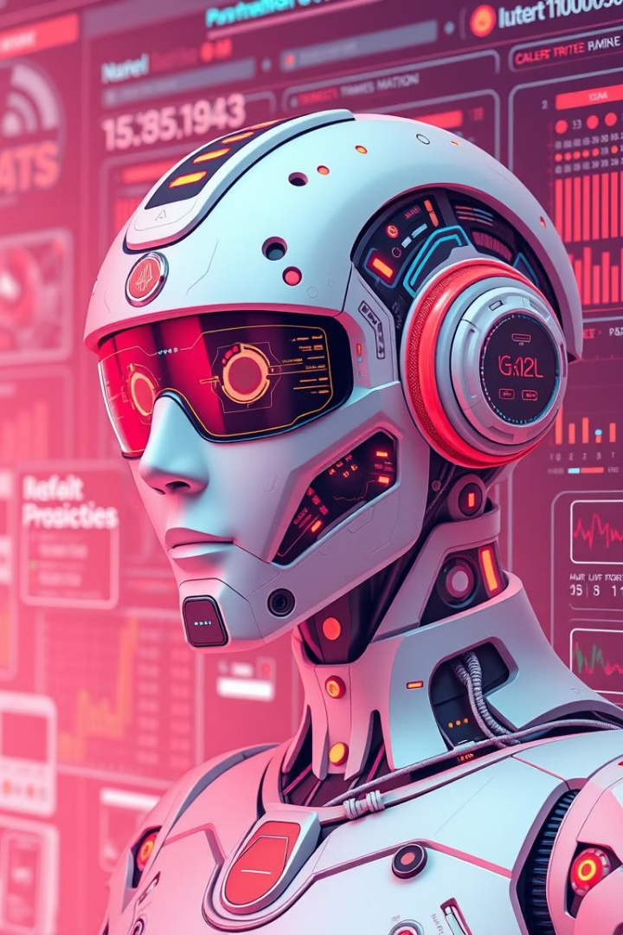
Addressing Limitations and Challenges
False Positives/Negatives
Adversarial Attacks
Monitoring evolving phishing techniques and defenses.
Continual model retraining reduces errors.
Ethical Considerations
Ensuring privacy, reducing bias in AI decisions.

Slide 9





Future Enhancements: Expanding Capabilities and Improving Accuracy
Advanced NLP
Sentiment analysis to improve threat detection
Real-Time Updates
Integrating threat intelligence feeds continuously
Adaptive Learning
Models that evolve with new phishing tactics
Reinforcement Learning
Proactive defense through AI self-improvement

Slide 10
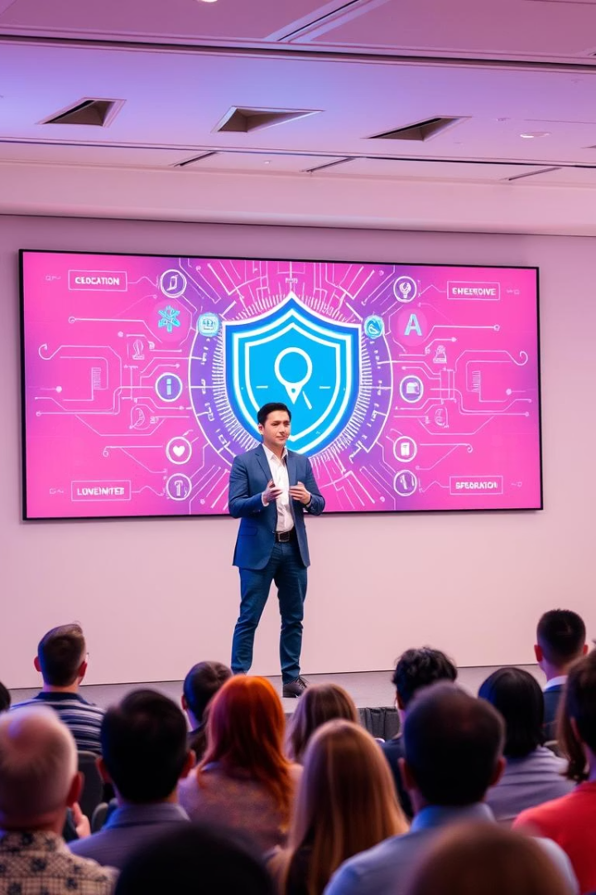
Conclusion: The Future of AI in Cybersecurity
Recap
Our AI model achieves superior phishing detection.
Impact
Transforming cybersecurity against advanced threats.
Call to Action
Adopt AI solutions for safer digital environments.
Next Steps
Further research and system enhancements underway.
Thank you. Questions and discussion welcome.

